Slide 1

Lead Scoring - Case Study

Slide 2
Content :
Data Cleaning
EDA (Exploratory Data Analysis)
Data Preparation for Model Building
Building a Model
Model Evaluation and Prediction
Conclusion

Slide 3

Data Cleaning

Slide 4
Importance of Data Cleaning
Data cleaning is crucial before performing data analysis or applying machine learning techniques because:
Accuracy: Ensures the data is accurate and free of errors, leading to more reliable results.
Consistency: Removes inconsistencies and standardizes the data, making it uniform.
Completeness: Fills in missing values and removes incomplete records, ensuring comprehensive analysis.
Performance: Improves the efficiency and performance of algorithms by eliminating irrelevant or redundant data.
Insights: Enhances the quality of insights and decisions derived from the data.
Therefore,
We must Check for null values, Check for missing values, Handling missing values, Dropping unnecessary columns and finally checking for Duplicates.

Slide 5
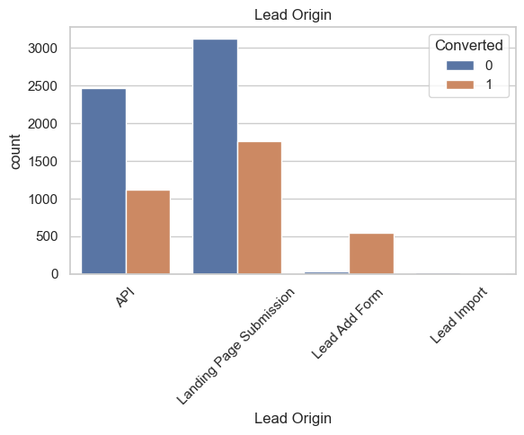
After Data Cleaning :
So, after performing various methods of cleaning the data, we come to this conclusion that 98% of the data has been retained after cleaning the data, removing the null values and standardizing some of the rows and also there are no duplicates present as well.
Now based on our data cleaning if check with a count plot for Lead origin we can infer the following :
Landing page submission has both the highest and lowest conversion rate.
API comes in the 2nd place with highest and lowest conversion rate.
Lead import has no conversions
Lead add form has the highest ratio in terms of conversion to no conversion.

Slide 6

EDA

Slide 7
Importance of EDA
Exploratory Data Analysis (EDA) is important before applying any machine learning techniques because:
Understanding Data: Provides insights into the structure, patterns, and relationships within the data.
Identifying Anomalies: Helps detect outliers, missing values, and errors that need to be addressed.
Feature Selection: Assists in identifying relevant features and reducing dimensionality for better model performance.
Hypothesis Testing: Allows you to test assumptions and hypotheses about the data.
Data Distribution: Helps understand the distribution of variables, which informs the choice of algorithms and preprocessing steps.
Improving Models: Guides the preprocessing steps and feature engineering, leading to more accurate and efficient models.

Slide 8
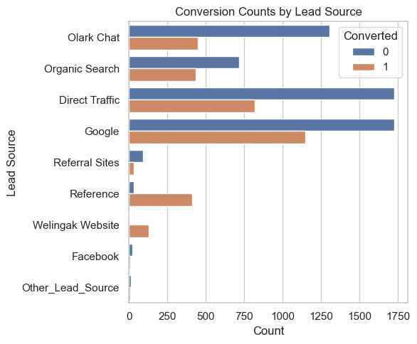
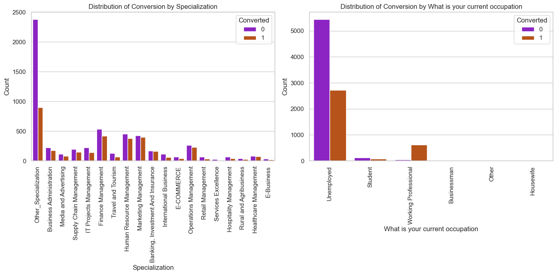
Now based on the conversion counts of various lead sources. We can see that ,
Google has the highest count of conversions of leads.
In the 2nd place is Direct traffic.
Quite surprisingly Facebook has a low conversion rate, given the stature of the medium it seems a better decision not advertise on Facebook.
For Specialization we can see that Others and Finance management have highest conversion rates.
In terms of occupation Unemployed have the highest non-conversion rate

Slide 9
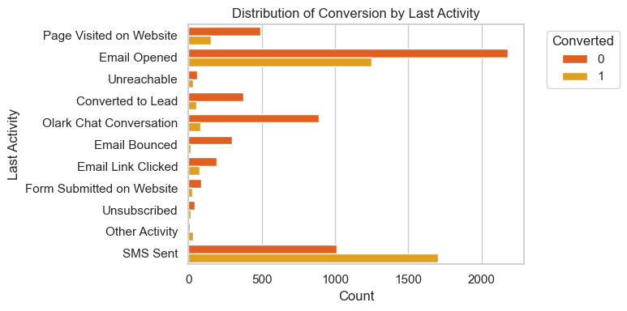
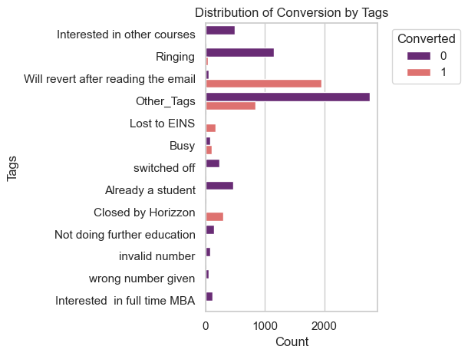
Conversion based on the last activity shows that SMS sent and Email Opened have the highest conversion rates.
Also we can see that Email Opened has the highest rate of non conversion as well.
Here based on the Tags we can see that other tags have highest rate of non-conversion.
Whereas, reverting back after reading the email has the highest rate of conversion.

Slide 10
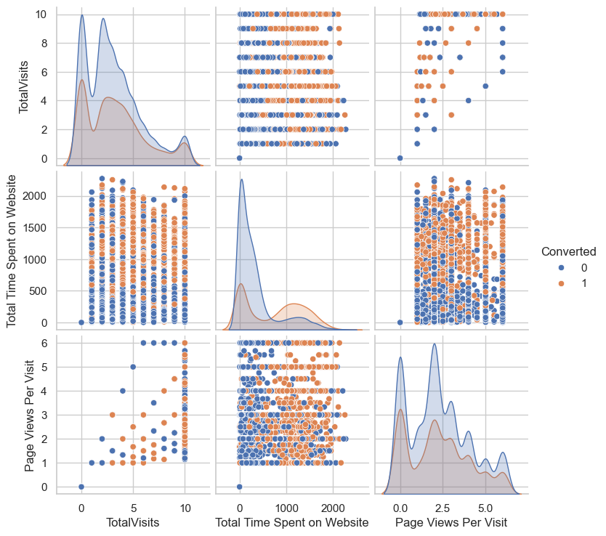
Now based on the Amount of time Spent on the website we can make the following inferences:
Total Time Spent on Website: Shows a positive correlation with conversions
Page Views Per Visit: Also indicates a positive correlation
Total Visits: Does not show a clear trend with conversions

Slide 11
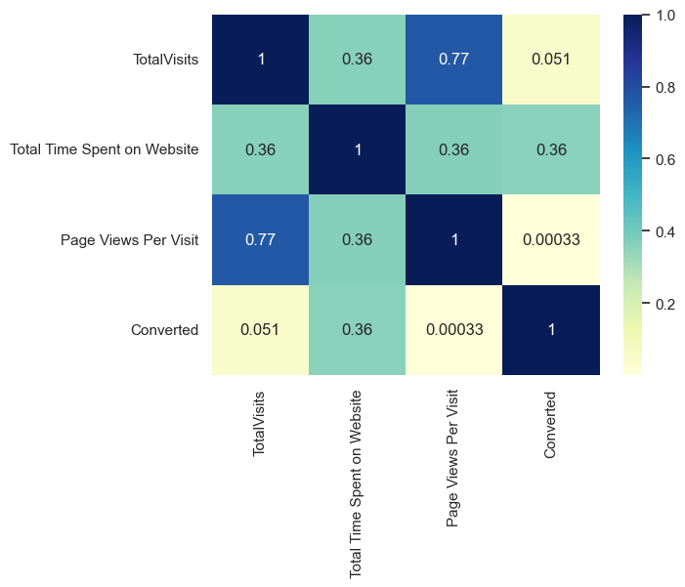
Now based on the Amount of time Spent on the website we can make the following inferences:
Total Time Spent on Website: Has moderately low relation with conversion.
Page Views Per Visit: Has a very low relation with conversion.
Total Visits: Has moderate relation to conversion.

Slide 12

Data Preparation for model building

Slide 13
Data Preparation
Once our data cleaning is done and we have dropped the necessary columns and did our Univariate analysis now we start preparing our dataset for model building. Going through the following sequential steps.
Dummy Variable Creation
Train Test Split
Scaling
Looking at the correlations

Slide 14
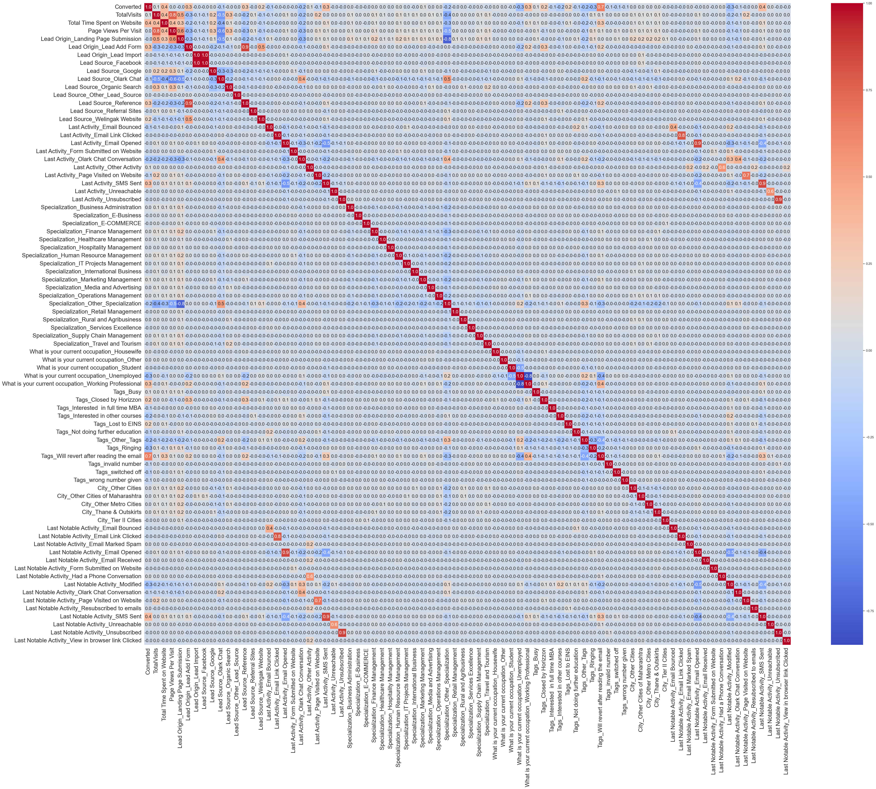
Now based on the heatmap we have generated we would not be able to see clearly because of the fonts but based on our previous Data visualization we can see a few clear pointers related to Conversion.
Total visits
Total time spent on the website.
Total page views.
SMS sent
Email received
Email opened etc.
Just to name a few are the places on the heatmap we can see have generated more heat in relation to conversion.

Slide 15

Model building

Slide 16

For our Model building – As we can see that there are a lot of variables present in the dataset which we cannot deal with. So the best way to approach this is to select a small set of features from this pool of variables using RFE.
What is RFE?

Slide 17
For our Model building we also need to check for the VIF values.
What is VIF? The Variance Inflation Factor (VIF) is a measure used to detect the presence and severity of multicollinearity in a regression model. Multicollinearity occurs when two or more predictor variables in the model are highly correlated, making it difficult to determine the individual effect of each predictor on the dependent variable.
Hence, Understanding and managing VIF is crucial for building robust regression models that provide reliable and interpretable results.

Slide 18
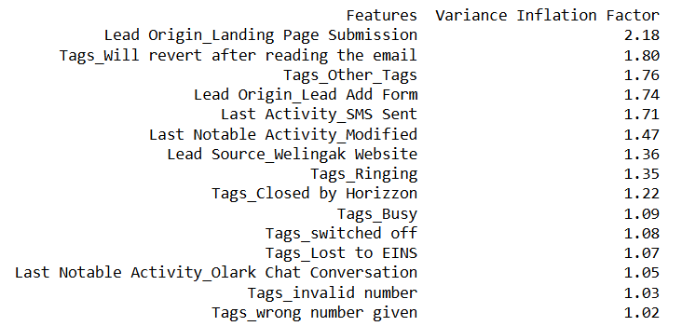
Going ahead as check for VIF values we can see that –
All variables have a good value of VIF. But we observed earlier that the column Tags_invalid number and Tags_wrong number given has high p-value and hence we will drop this column and remake the model.
Going ahead we will drop one or two variables at times based on their P-values and keep rebuilding a model until we get a proper model exhibiting proper P-values.

Slide 19
Now as go further we will keep dropping certain variables as we have already dropped Tags_invalid number and Tags_wrong number
Now we will also drop the following variables :
Lead Origin_Lead Add Form
Tags_Switched off
Now by this time we are going into our 5th model.
We can see that our P-values are fairly up to the mark.
And we have an accuracy score of 92.59%.

Slide 20
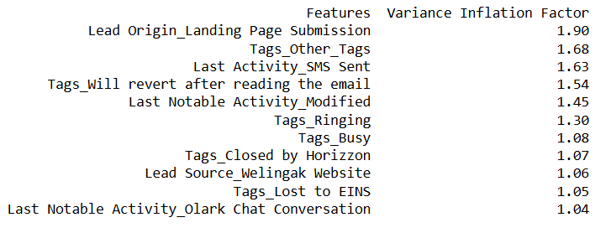
All variables exhibit satisfactory VIF and p-values. Therefore, there’s no need to eliminate any more variables, and we can continue to make predictions using this model as it is.

Slide 21

Model Evaluation and Prediction

Slide 22
Plotting ROC curve.
What is an ROC curve?
A Receiver Operating Characteristic (ROC) curve is a graphical representation used to evaluate the performance of a binary classification model. It plots the True Positive Rate (TPR) against the False Positive Rate (FPR) at various threshold settings.
Sensitivity and Specificity Tradeoff: The ROC curve illustrates the tradeoff between sensitivity (true positive rate) and specificity (true negative rate). Improving one typically reduces the other.
Area Under the Curve (AUC): A curve that closely follows the y-axis and the top border of the ROC space indicates a larger AUC, suggesting higher accuracy of the test or model.
Diagonal Reference Line: The closer the ROC curve is to the 45-degree diagonal line (the reference line), the smaller the AUC, indicating lower accuracy of the test or model.
Here, our goal is to have achieve good sensitivity score

Slide 23
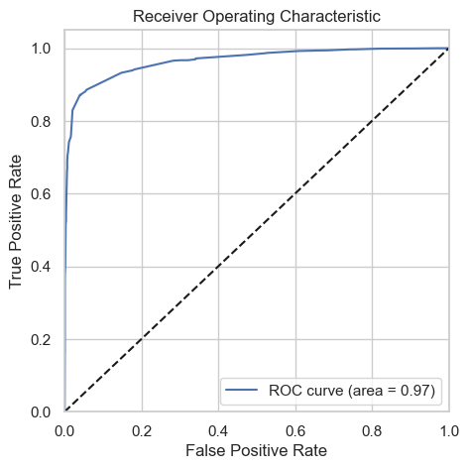
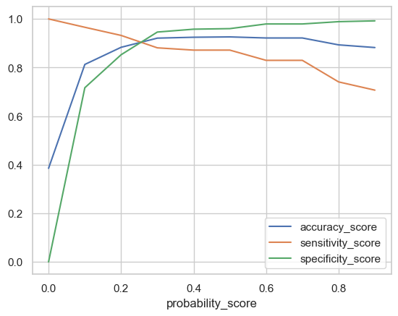
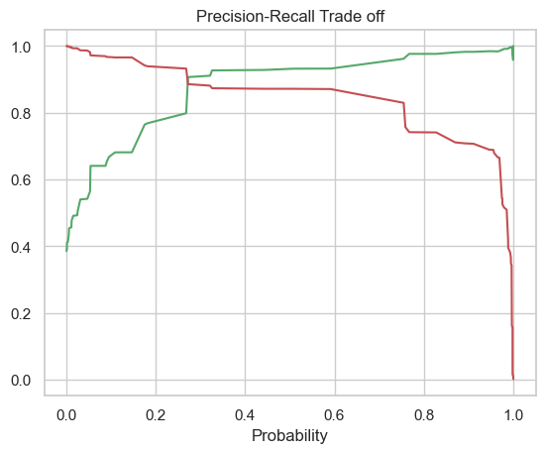
Sensitivity-Specificity-Accuracy Plot: At a probability cutoff of 0.27, the Sensitivity-Specificity-Accuracy plot suggests an optimal point. This cutoff balances sensitivity (true positive rate), specificity (true negative rate), and overall accuracy effectively.
Precision-Recall Curve: The Precision-Recall curve indicates that a cutoff probability of 0.3 is optimal. This threshold maximizes precision (positive predictive value) and recall (sensitivity) for the model.
Cutoff Probability Selection: Based on these analyses, 0.27 is chosen as the optimal cutoff probability for assigning Lead Scores in the training data. This ensures a balance between correctly identifying leads and minimizing misclassifications.

Slide 24
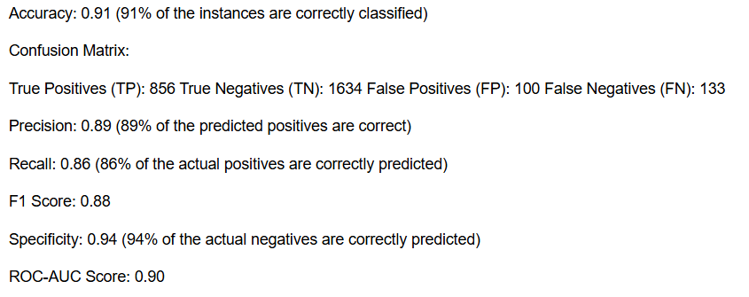
Results of our final Model:

Slide 25
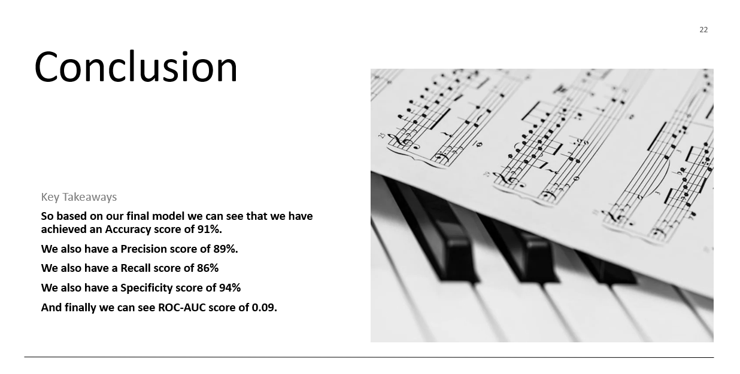

Slide 26
Thank you

